Slide 1
ECE 884 Deep Learning
Lecture 7: Regularization and Training
02/09/2021

Slide 2
Review of last lecture
Loss Function
What it is, what is it for?
Example: cross-entropy loss function

Slide 3
Today’s lecture
Regularization
What it is, what is it for?
Examples
Training

Slide 4
Problem of Loss Function
Loss functions encourage good performance on training data but we really care about test data
Credit: Justin

Slide 5
Overfitting
A model is overfit when it performs too well on the training data, but has poor performance for unseen data
Credit: Justin

Slide 6
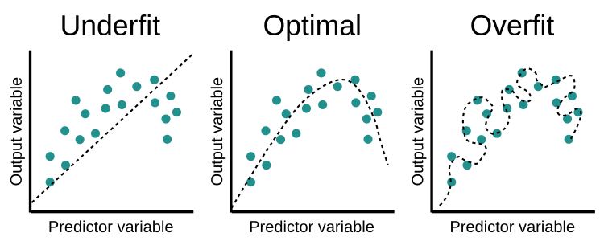
Overfitting
A model is overfit when it performs too well on the training data, but has poor performance for unseen data

Slide 7
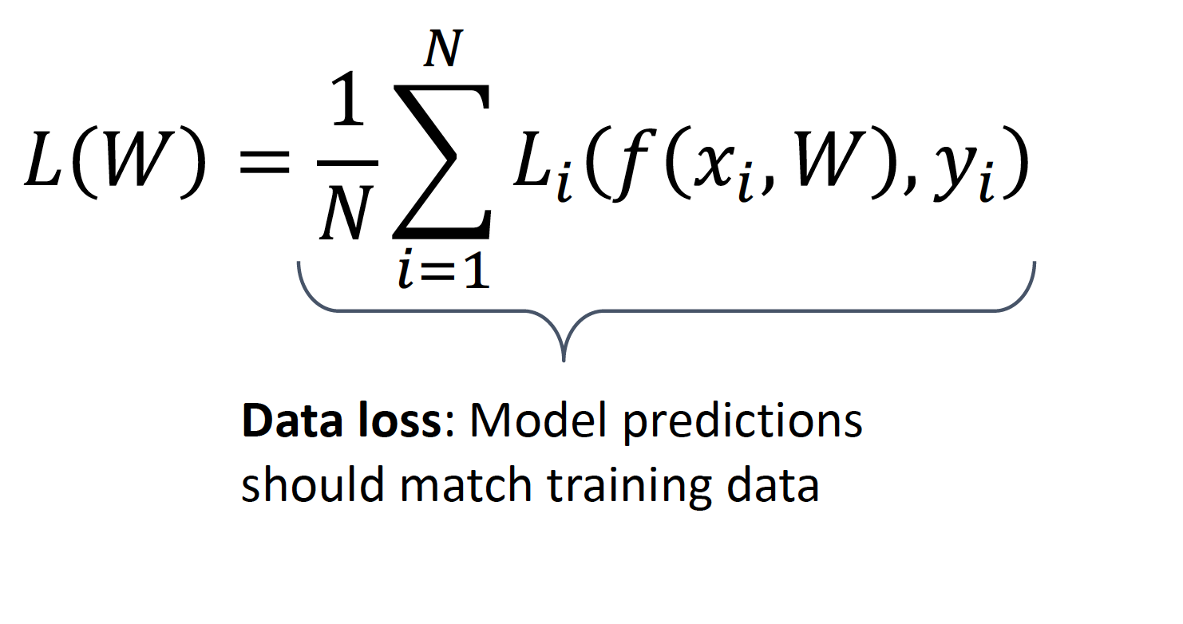
Regularization: Beyond Training Error
Credit: Justin

Slide 8
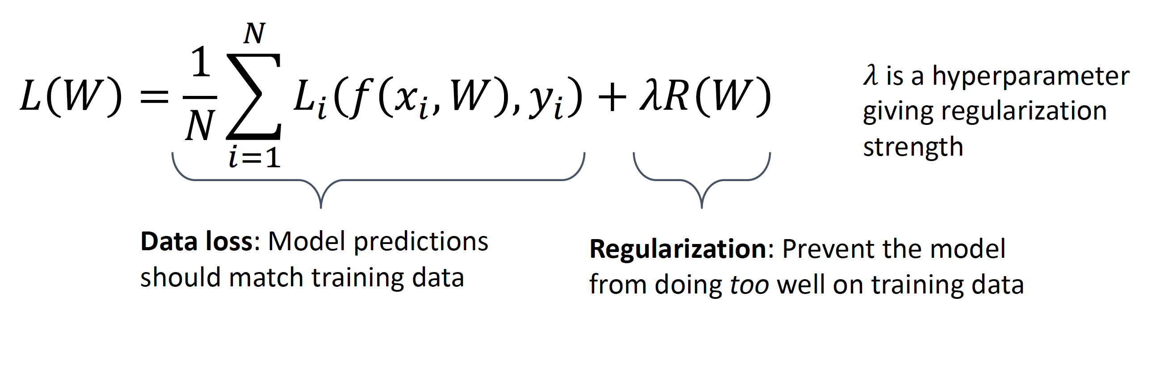
Regularization: Beyond Training Error
Credit: Justin

Slide 9
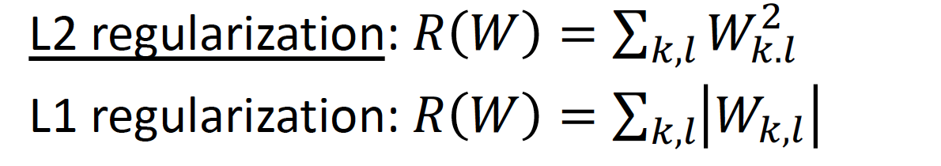
Example Regularization
Credit: Justin

Slide 10
Regularization Effect#1
Select simpler model with lower order

Slide 11
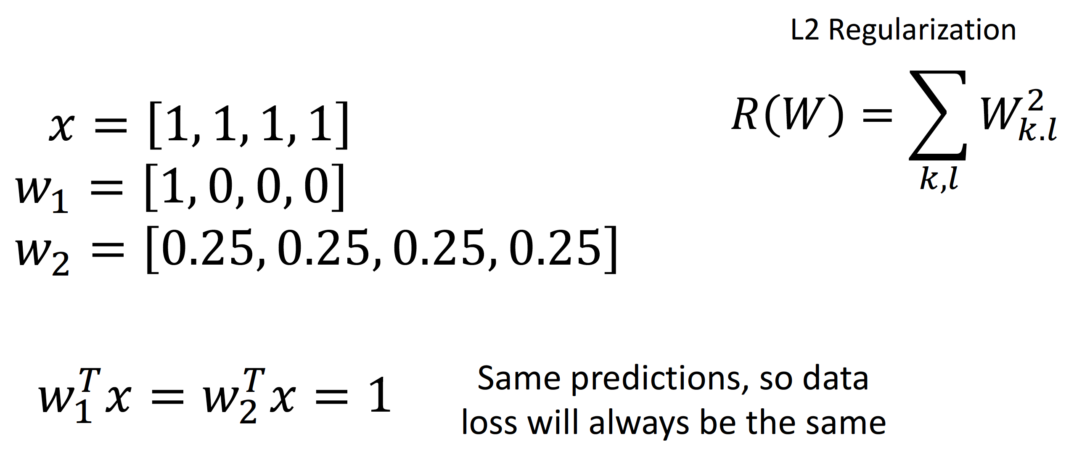
Regularization Effect#2
Select model with more features
Credit: Justin

Slide 12
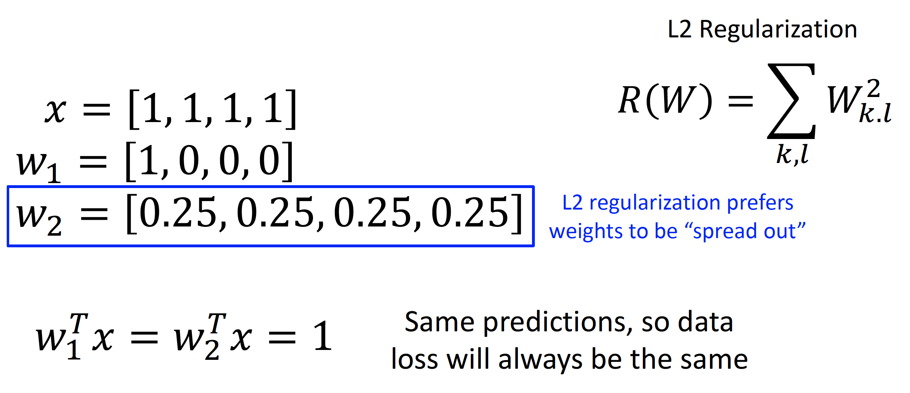
Regularization Effect#2
Select model with more features
Credit: Justin

Slide 13
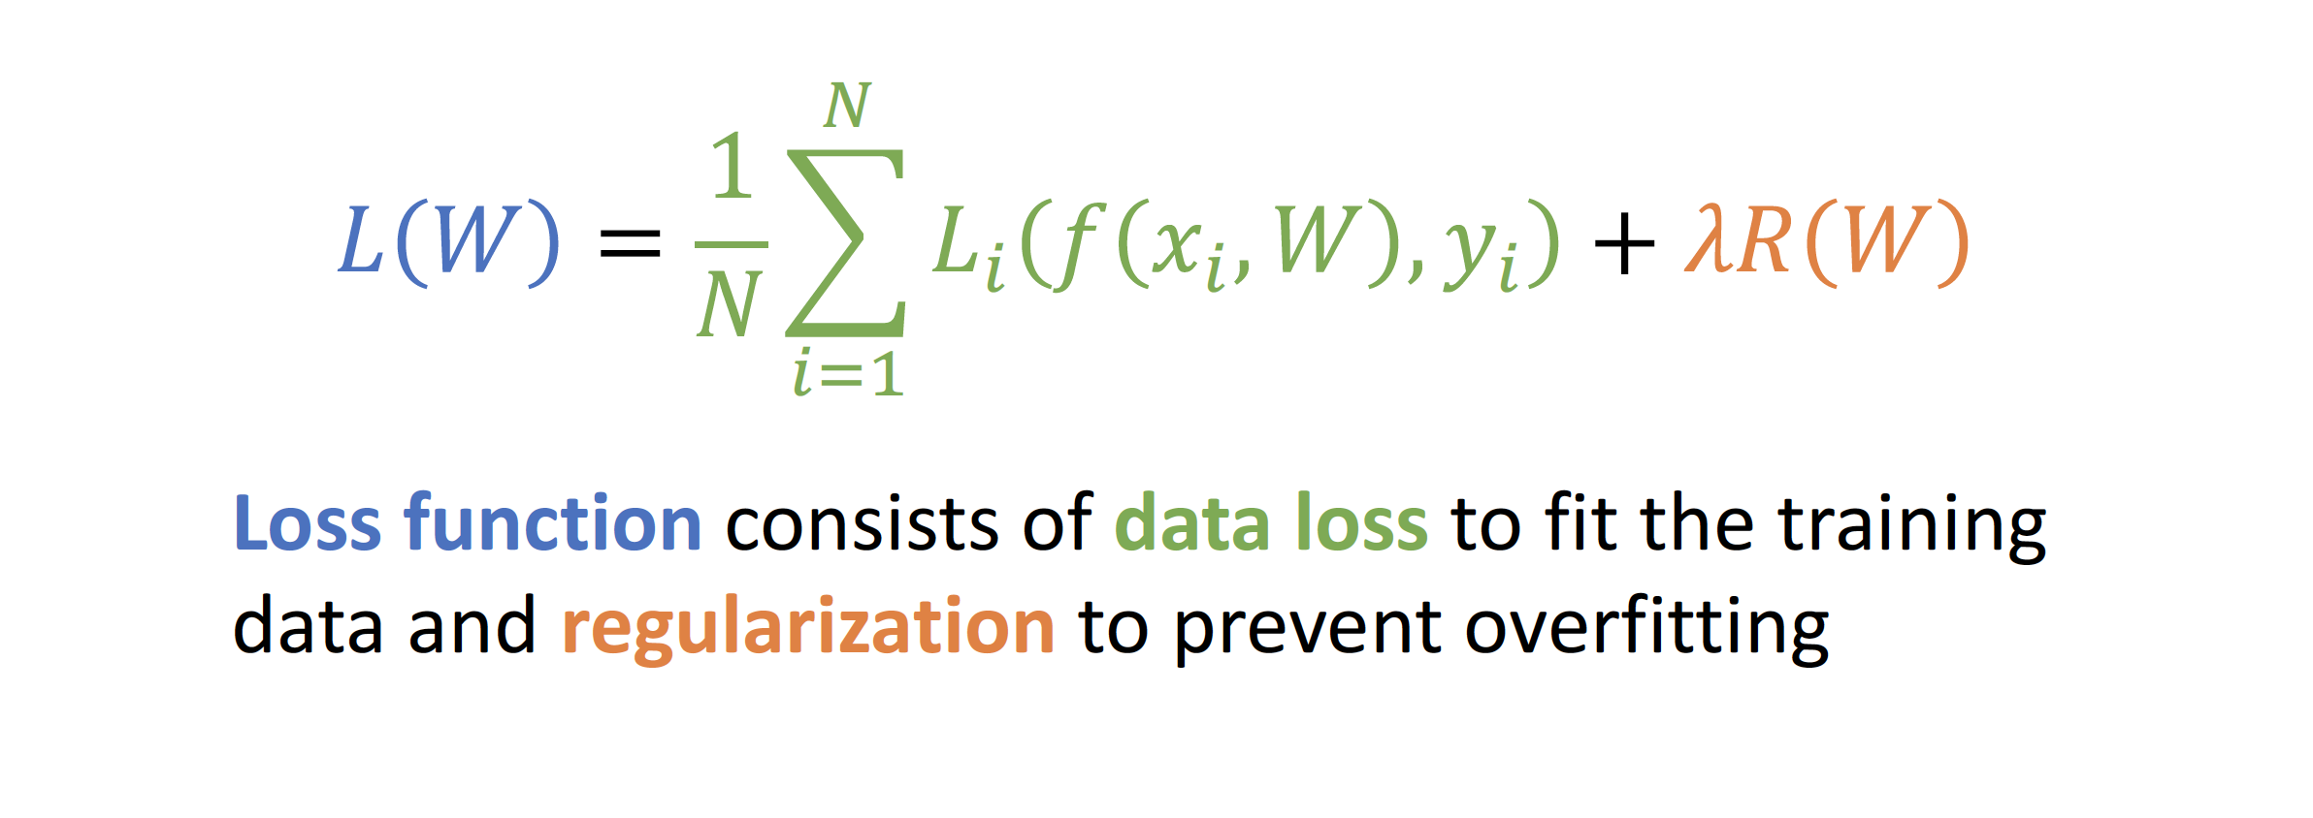
Summary
Credit: Justin

Slide 14
Training
What is the purpose of training?
Find the model weights W that achieve the lowest total loss based on the training dataset

Slide 15
𝑤∗ = arg min 𝐿 𝑤
Training
What is the purpose of training?
Training == Loss Optimization Problem
w

Slide 16
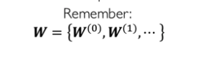
𝑤∗ = arg min 𝐿 𝑤
Training
What is the purpose of training?
Find the model weights W that achieve the lowest total loss based on the training dataset
w

Slide 17
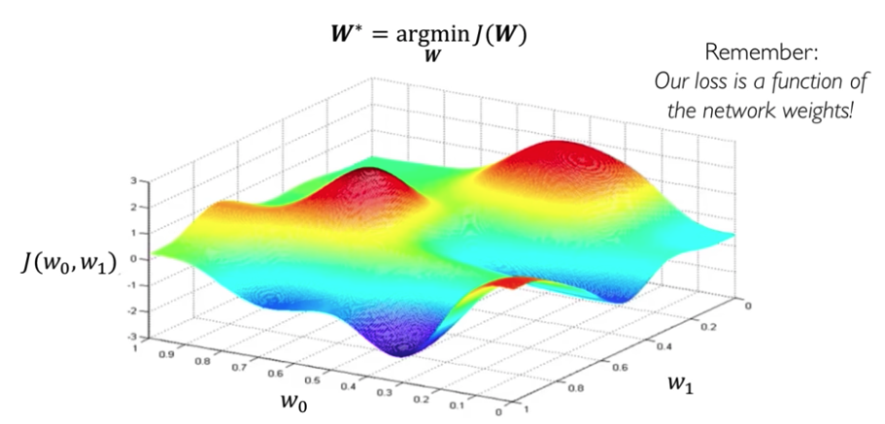
Optimization Landscape

Slide 18
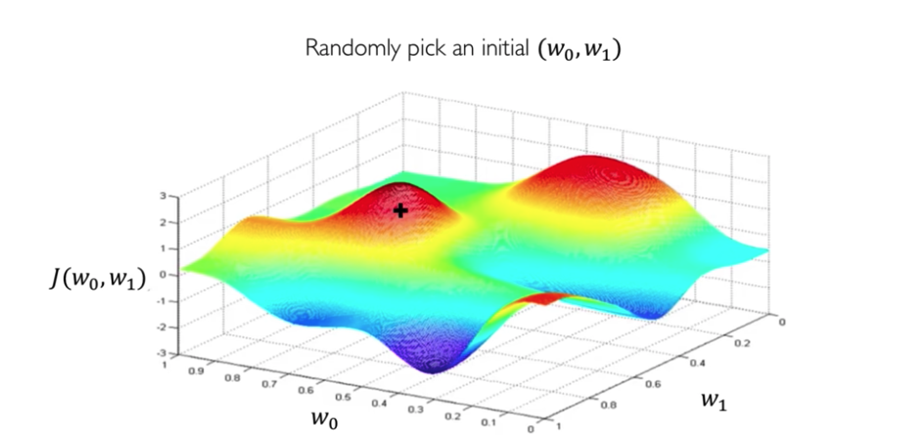
Optimization Method: Gradient Decent

Slide 19
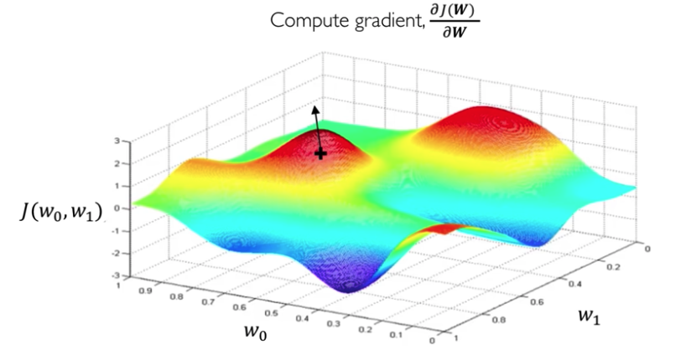
Optimization Method: Gradient Decent
Why computing gradient?
What does gradient represent?

Slide 20
Optimization Method: Gradient Decent
Directions

Slide 21
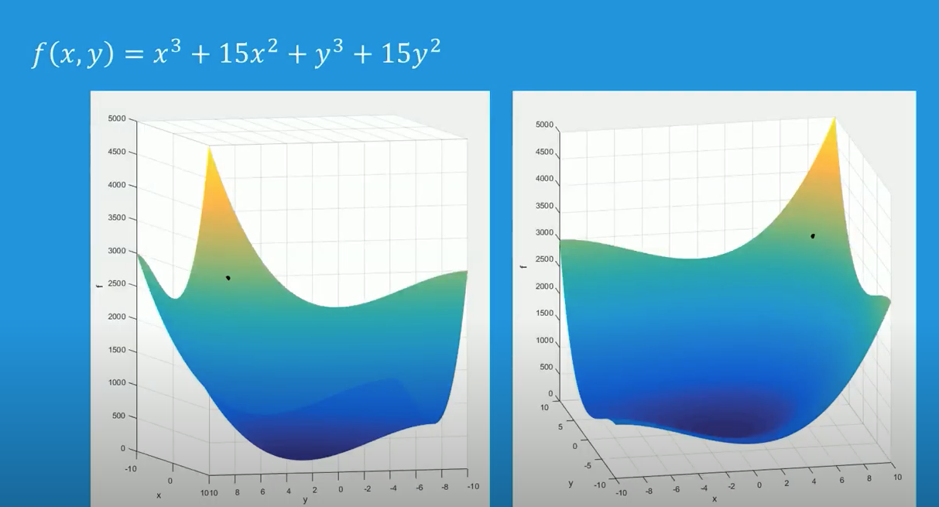
Optimization Method: Gradient Decent

Slide 22
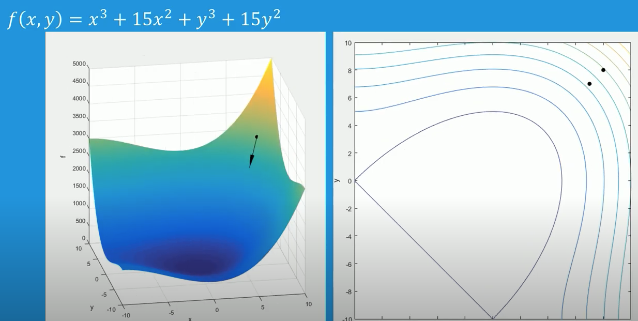
Optimization Method: Gradient Decent

Slide 23
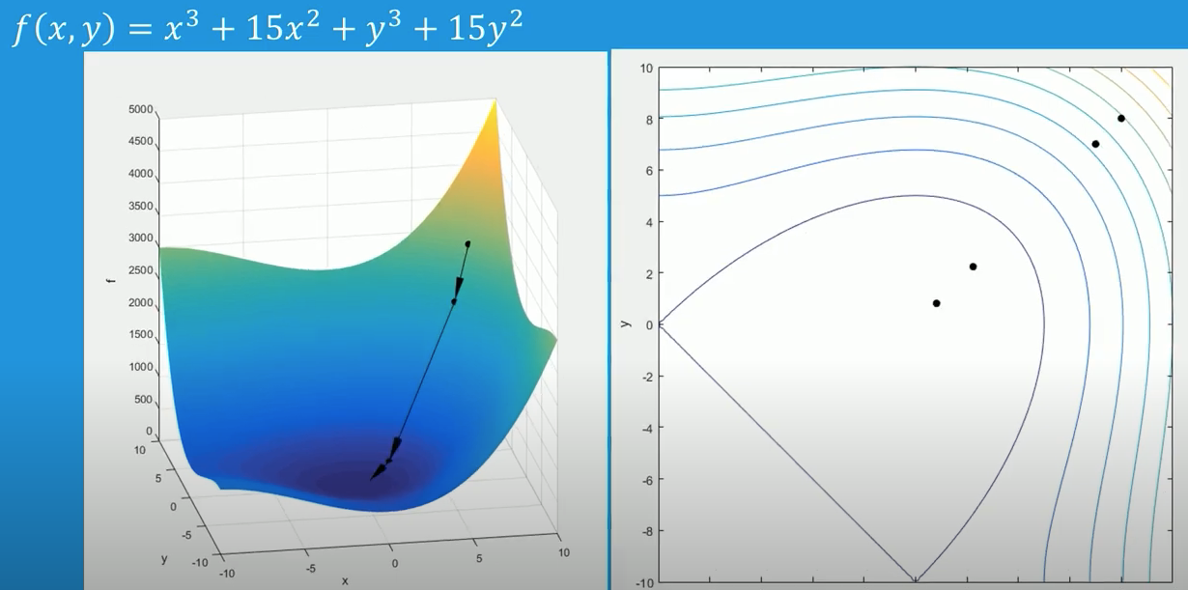
Optimization Method: Gradient Decent

Slide 24
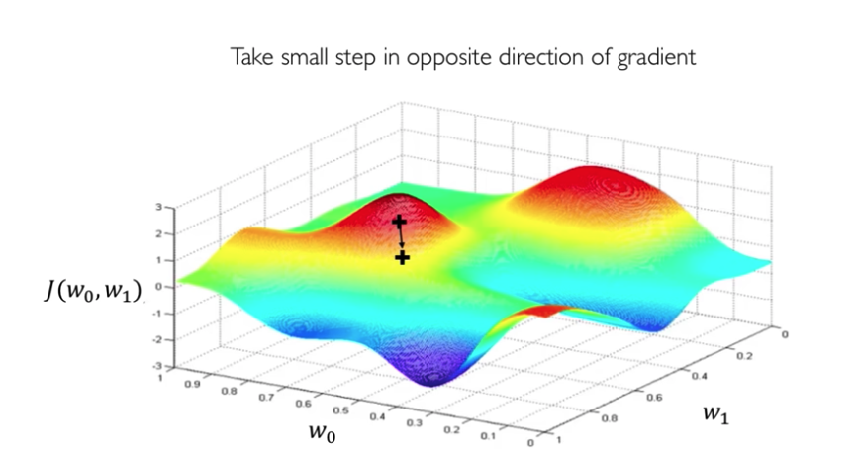
Optimization Method: Gradient Decent

Slide 25
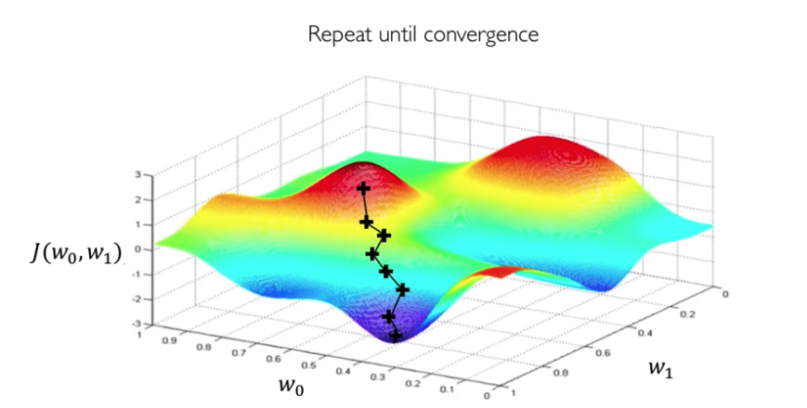
Optimization Method: Gradient Decent

Slide 26
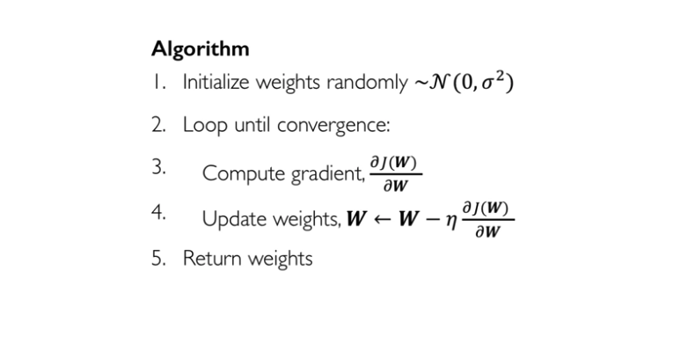
Optimization Method: Gradient Decent

Slide 27
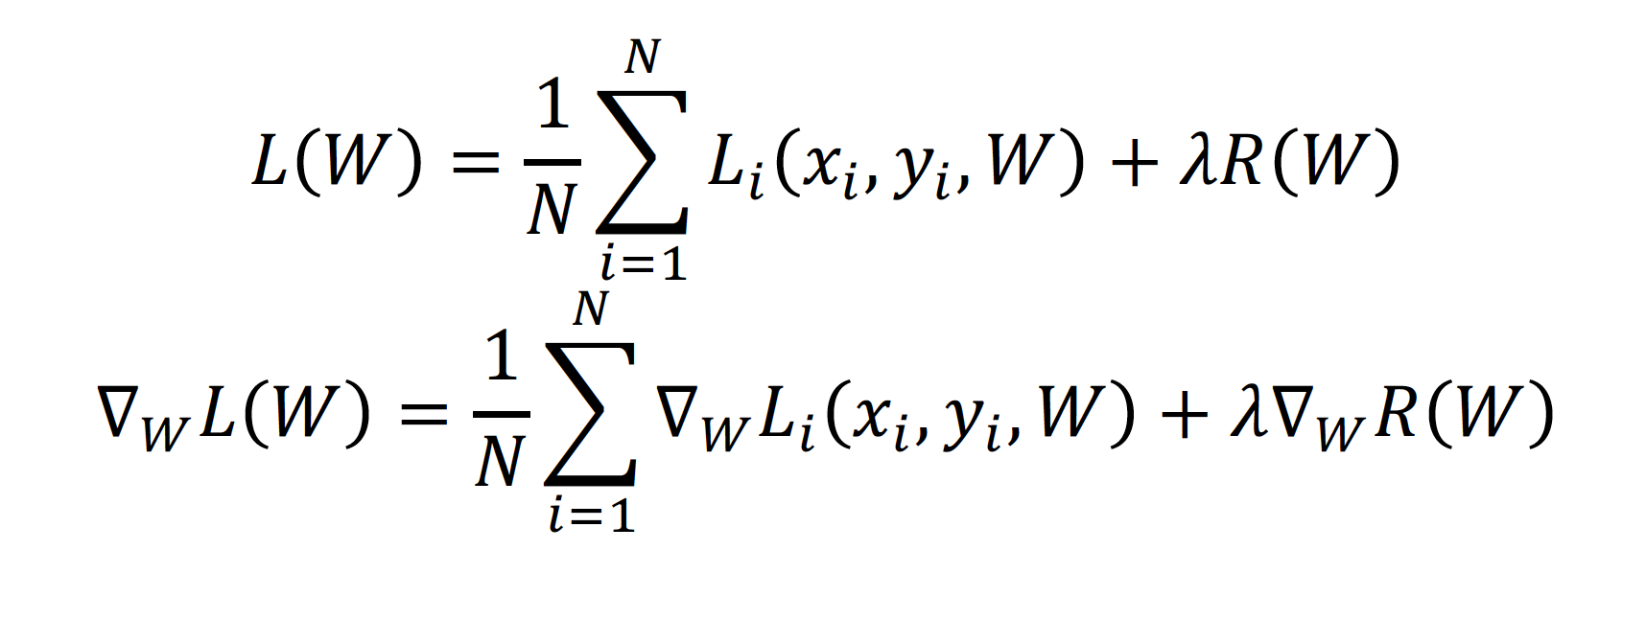
Batch Gradient Descent
Problem: This is very expensive when N is large!

Slide 28
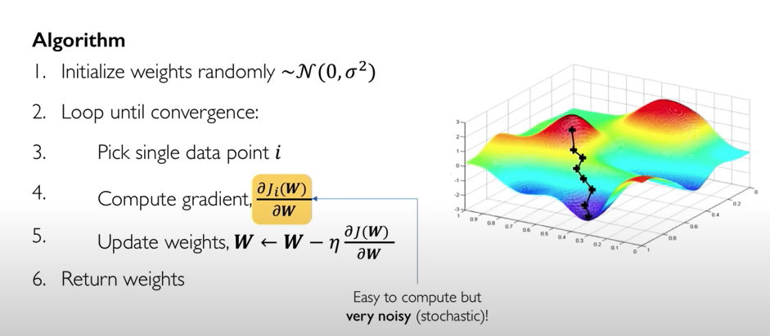
Stochastic Gradient Descent (SGD)
Single point to calculate GD

Slide 29
Stochastic Gradient Descent (SGD)
Problem: calculated gradient decent is noisy!

Slide 30
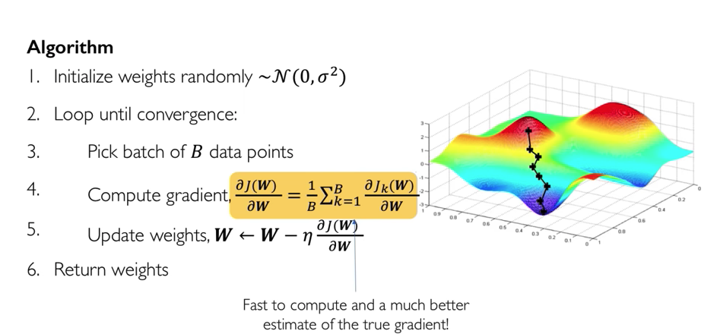
Stochastic Gradient Descent (SGD)
Approximate sum using a minibatch of 32 / 64 / 128 examples

Slide 31
Hyperparameters of Stochastic Gradient Descent (SGD)
Hyperparameters:
Weight initialization
Number of steps
Learning rate
Batch size
Data sampling

Slide 32
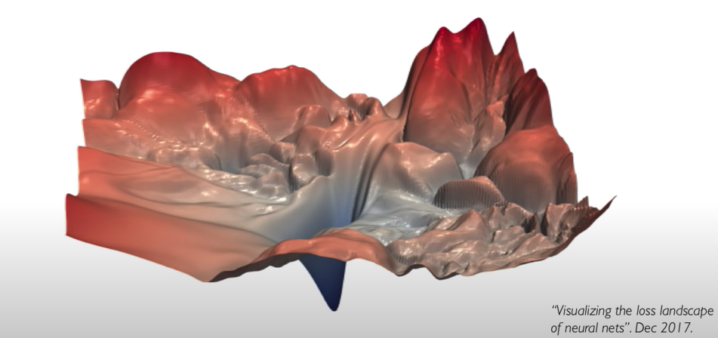
Initialization Matters a lot!

Slide 33
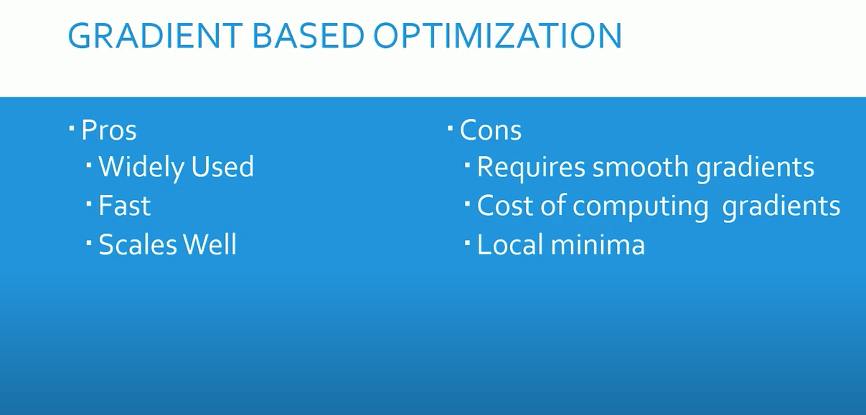
Pros and Cons

Slide 34
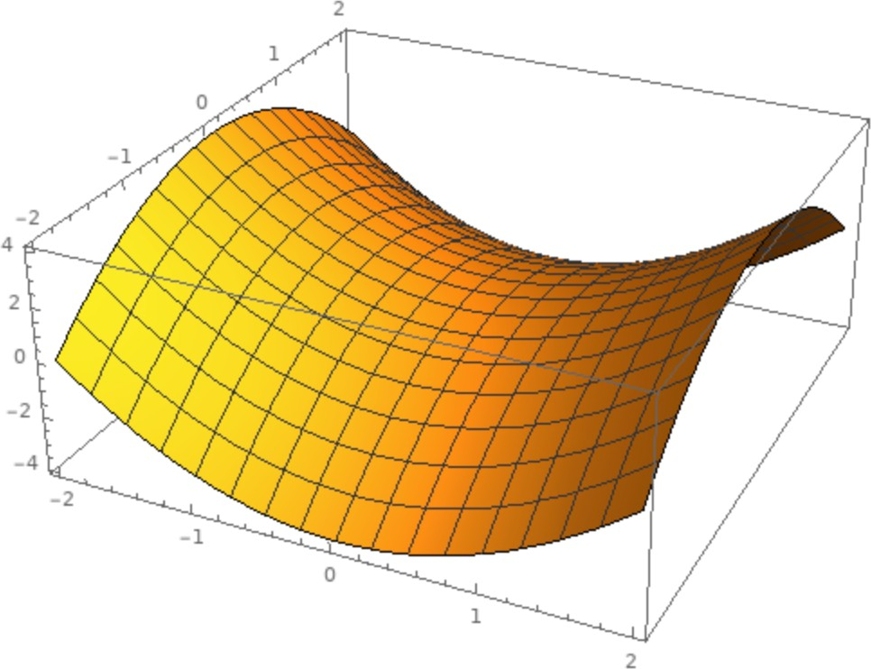
Problem#1 with SGD
Local Minimum
What if the loss function has a local minimum or saddle point?
Saddle point
Credit: Justin

Slide 35

Problem#1 with SGD
Local Minimum
What if the loss function has a local minimum or saddle point?
Saddle point
Zero gradient, gradient descent gets stuck
Credit: Justin

Slide 36
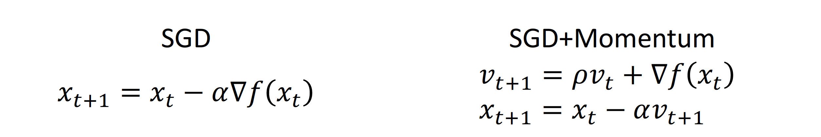
SGD + Momentum
V is velocity as a moving average of gradients.
Credit: Justin

Slide 37

SGD + Momentum
Local Minima
Saddle points
Credit: Justin

Slide 38
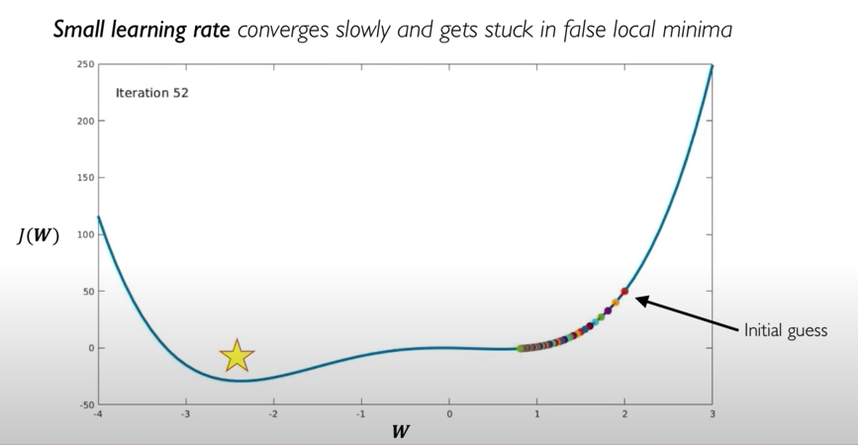
Problem#2 with SGD: Learning Rate

Slide 39
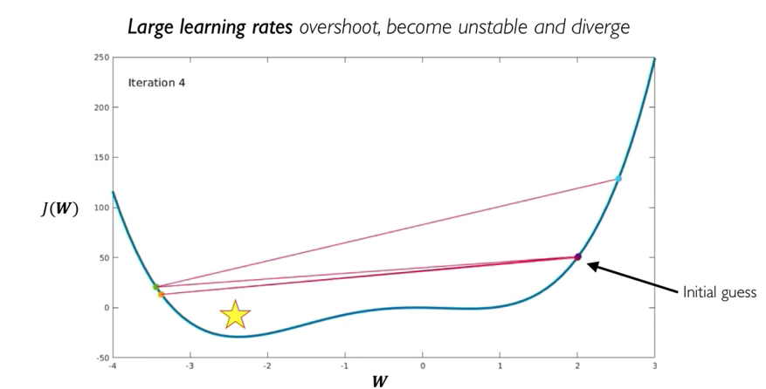
Problem#2 with SGD: Learning Rate

Slide 40
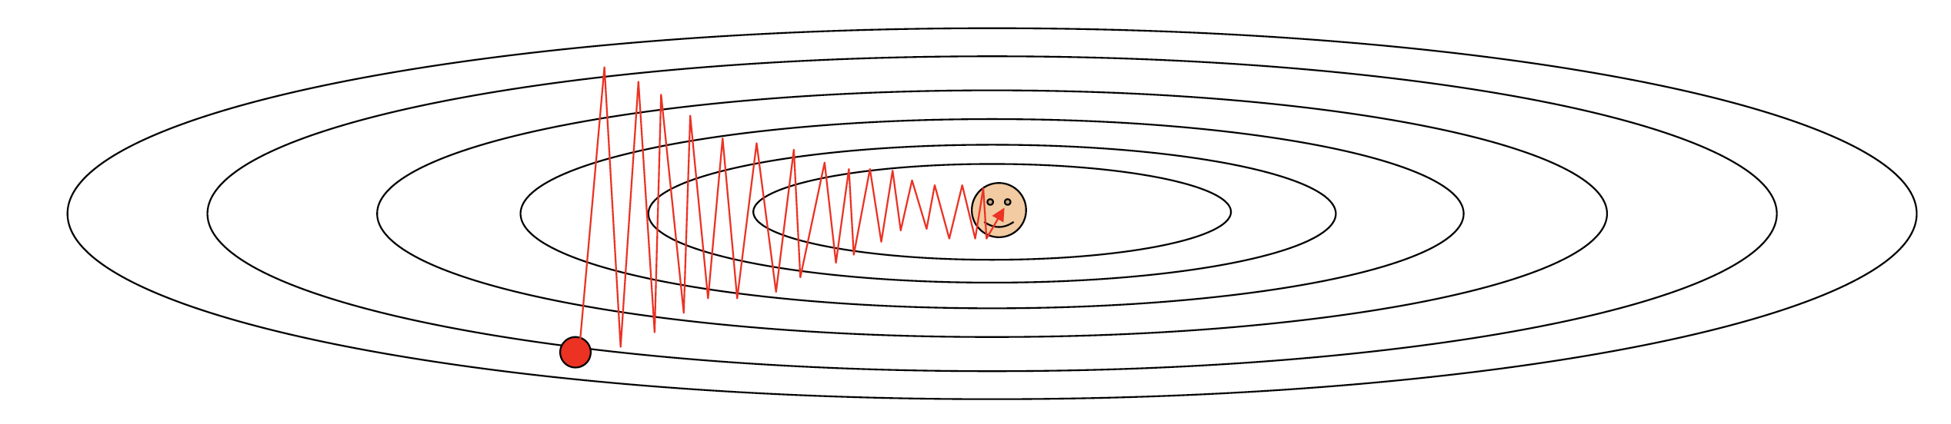
Optimizers with Adaptive Learning Rate
RMSProp
AdaGrad
Adam == Momentum + RMSProp
AdamW
Per-parameter learning rate
Learning rate decay

Slide 41
In practice:
Adam / AdamW is a good default choice in many cases SGD+Momentum can outperform Adam but may require more tuning

Slide 42
Any Question ?

